Slide 1
LAB 7. Networking: Creating a workgroup using a Switch
Deliverable To:Peter Wheeler
Deliverable By :Kulbir Singh Dhindsa
Gurinder Singh Kang

Slide 2
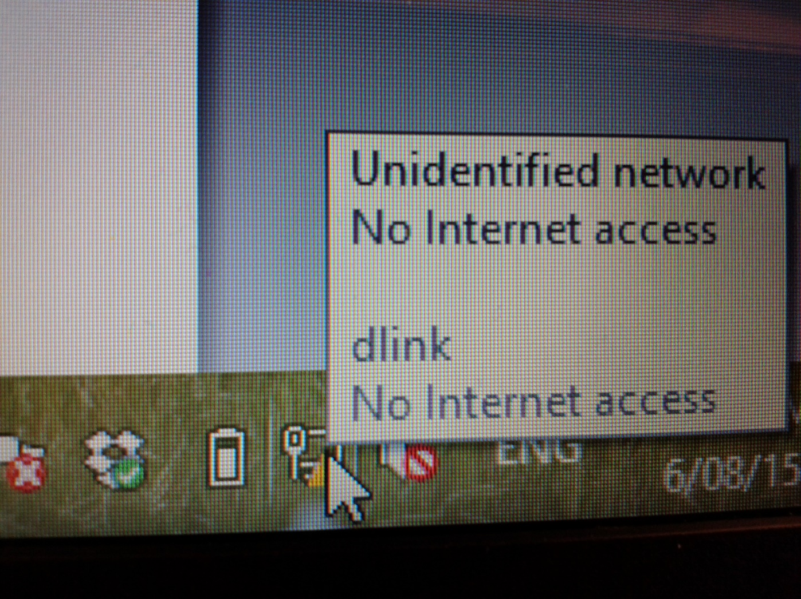
Firstly, Connect both the PCs to the switch

Slide 3
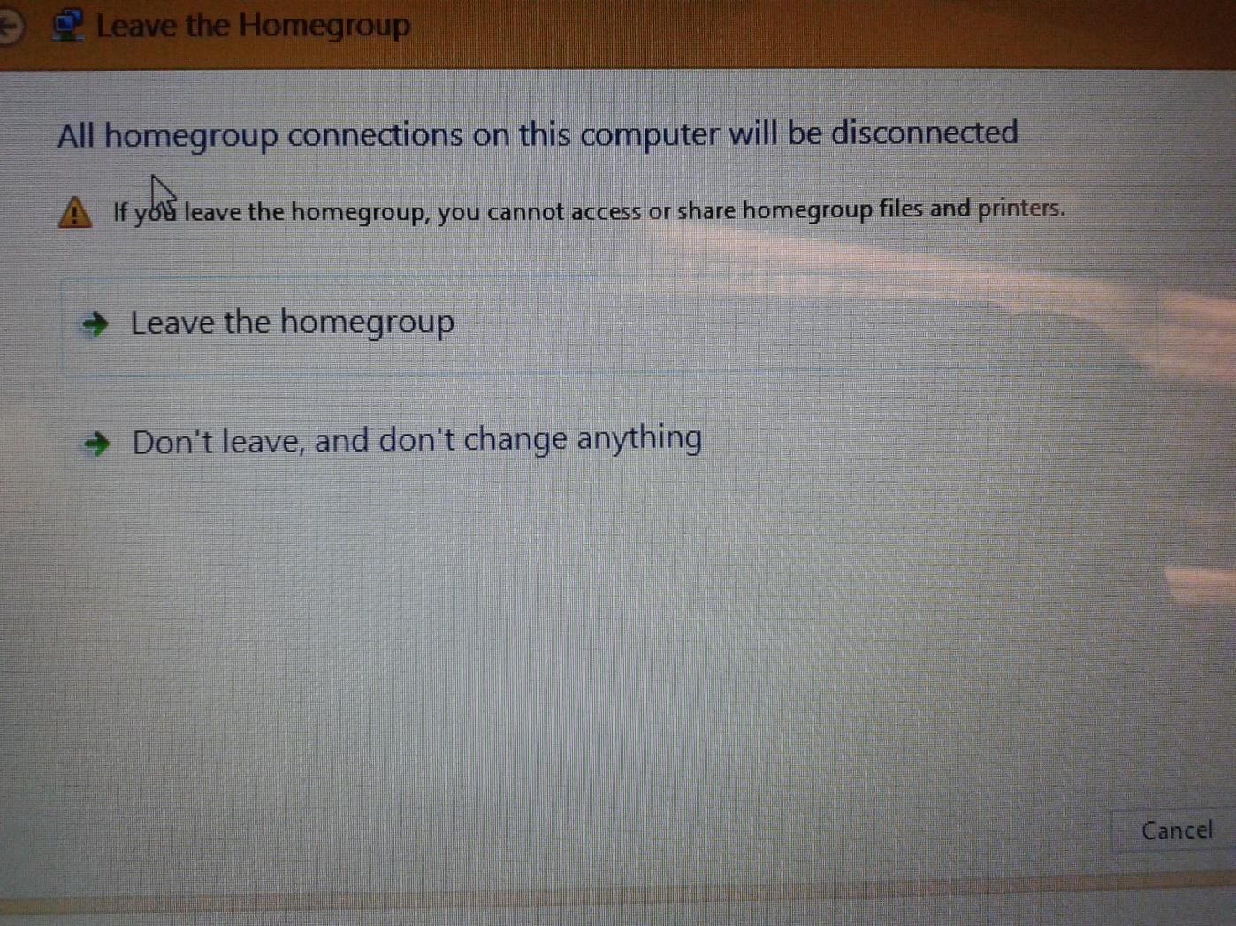
Now, Disconnect all the previous homegroup connections

Slide 4
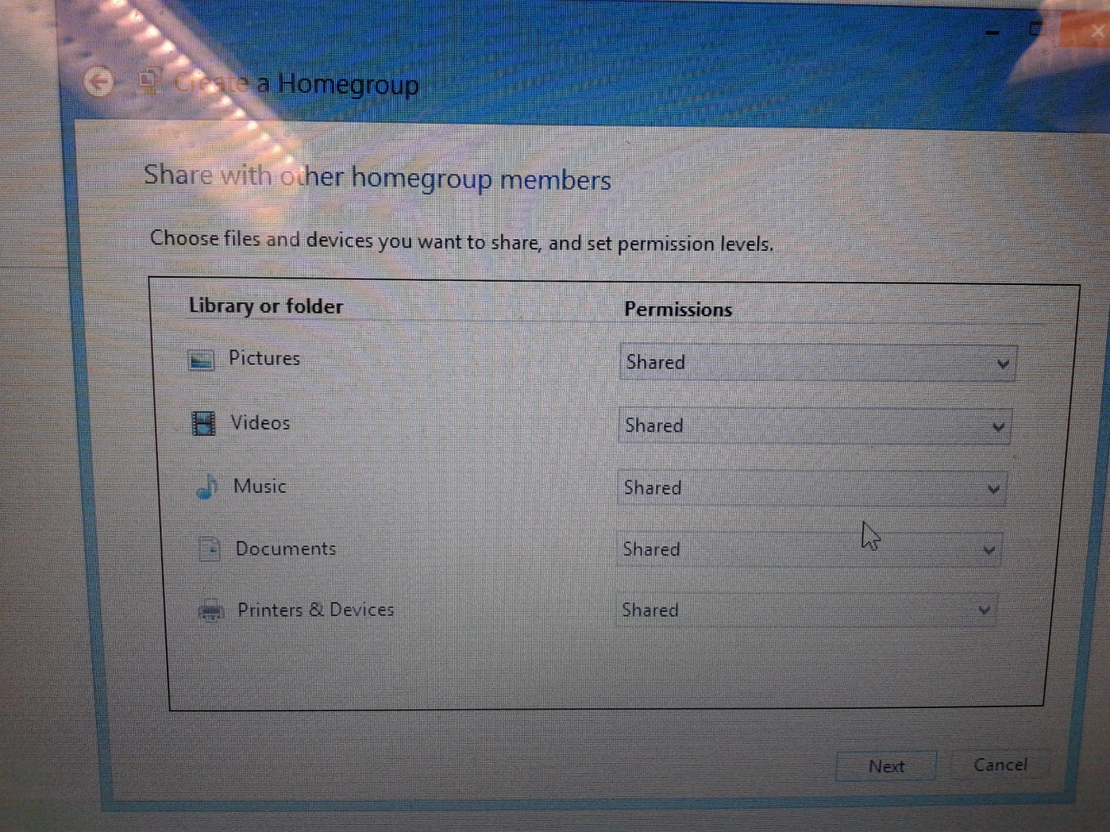
Create a homegroup and library or folder’s permission should be shared

Slide 5
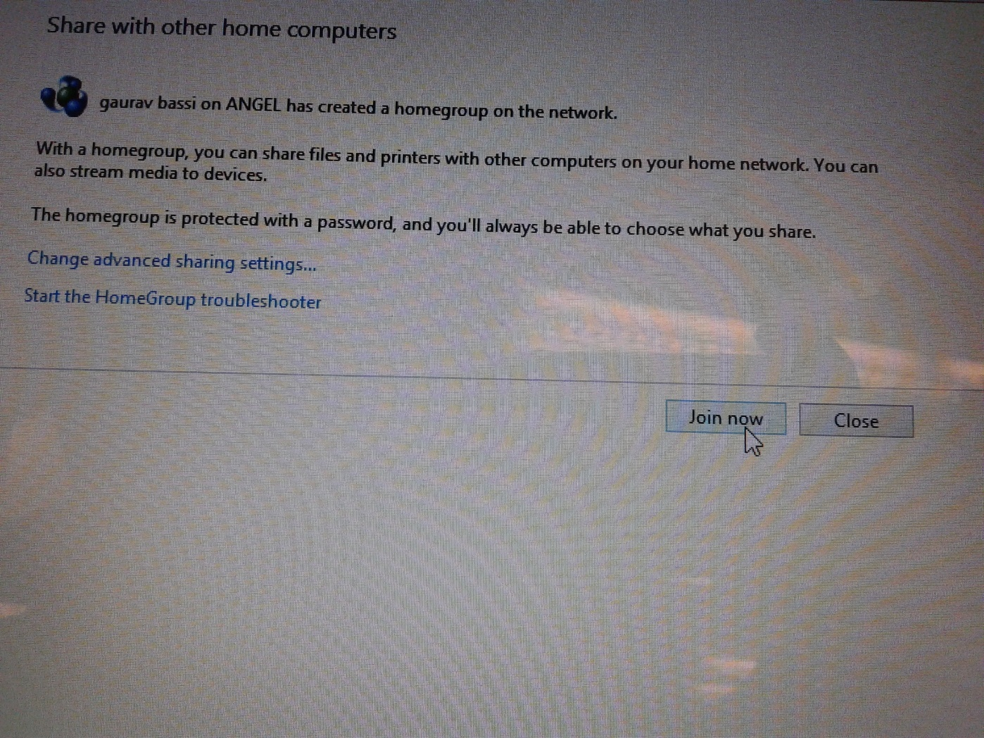
Now, click on “Join now”

Slide 6
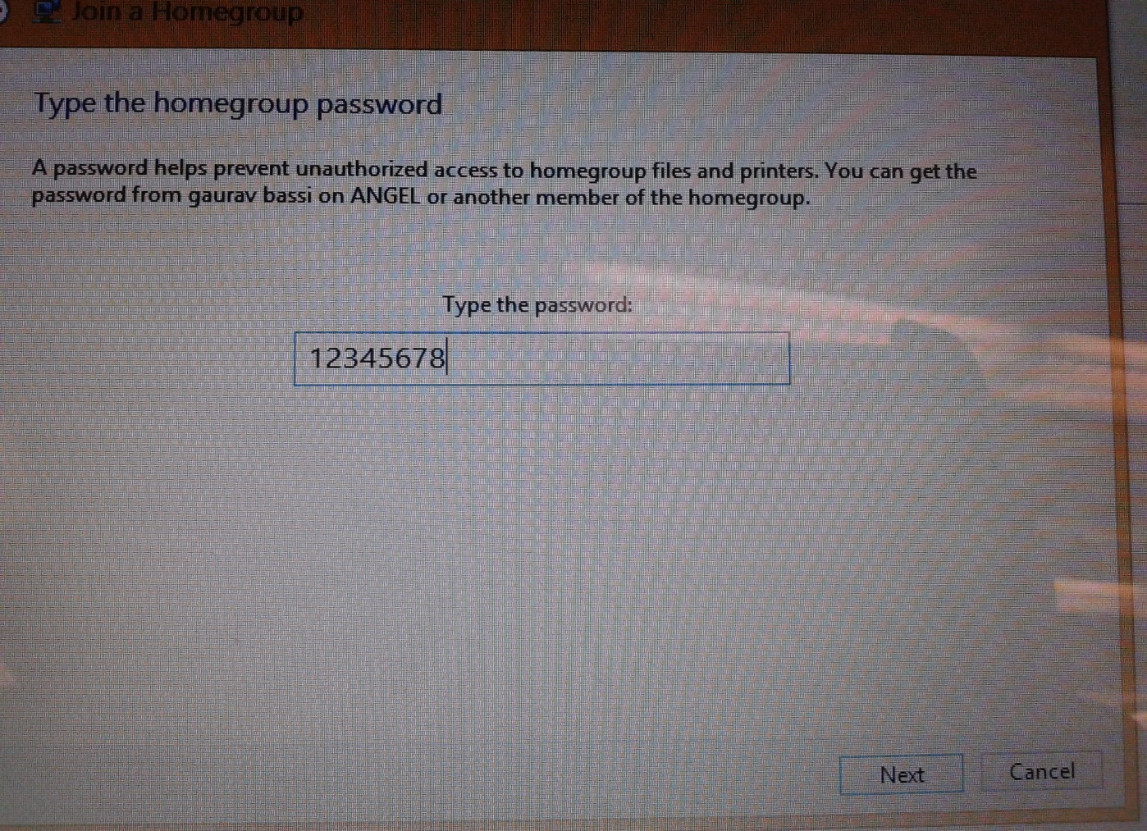
You have to enter password to join home group

Slide 7
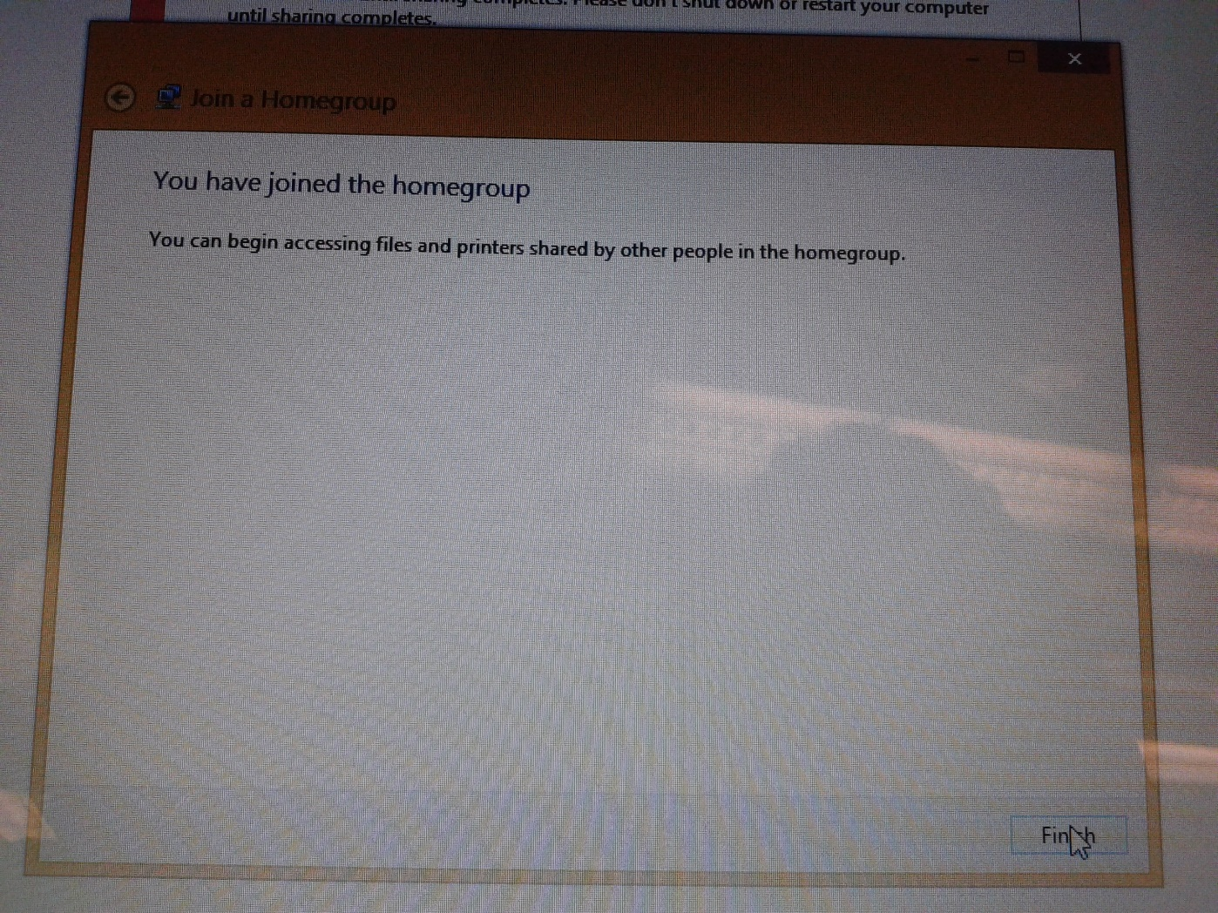
You have joined the homegroup

Slide 8
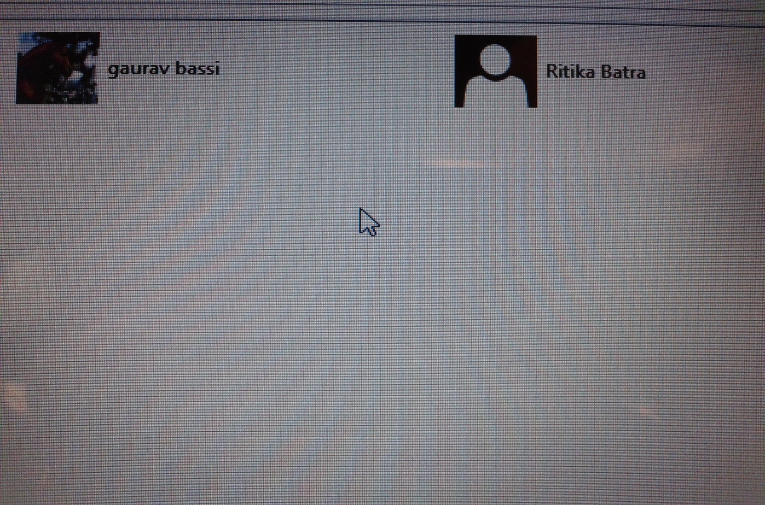
Homegroup are joined and ready to share documents

Slide 9
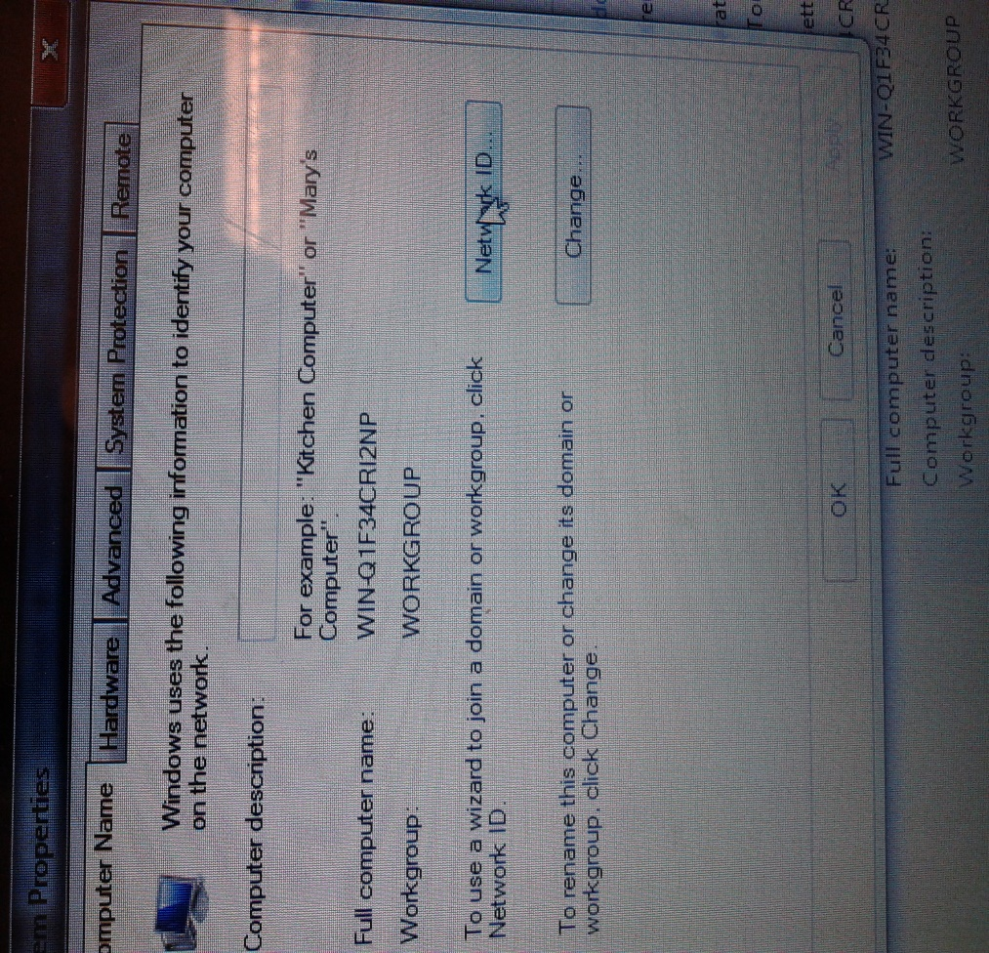
To join domain or workgroup, click Network ID

Slide 10
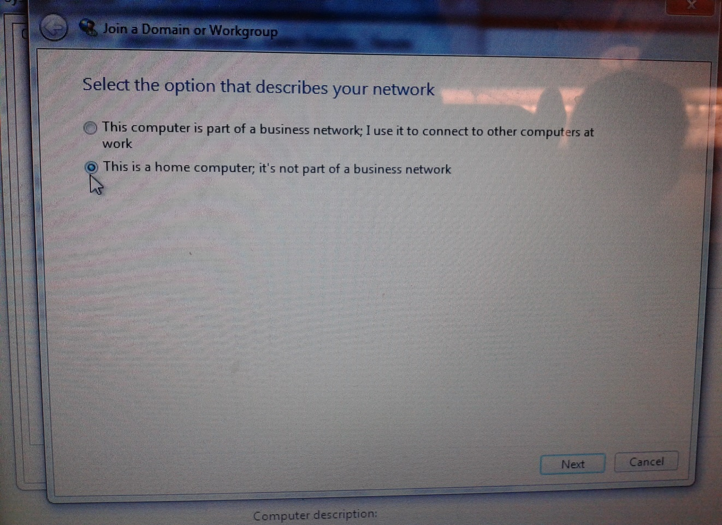
Select the option of home computer

Slide 11
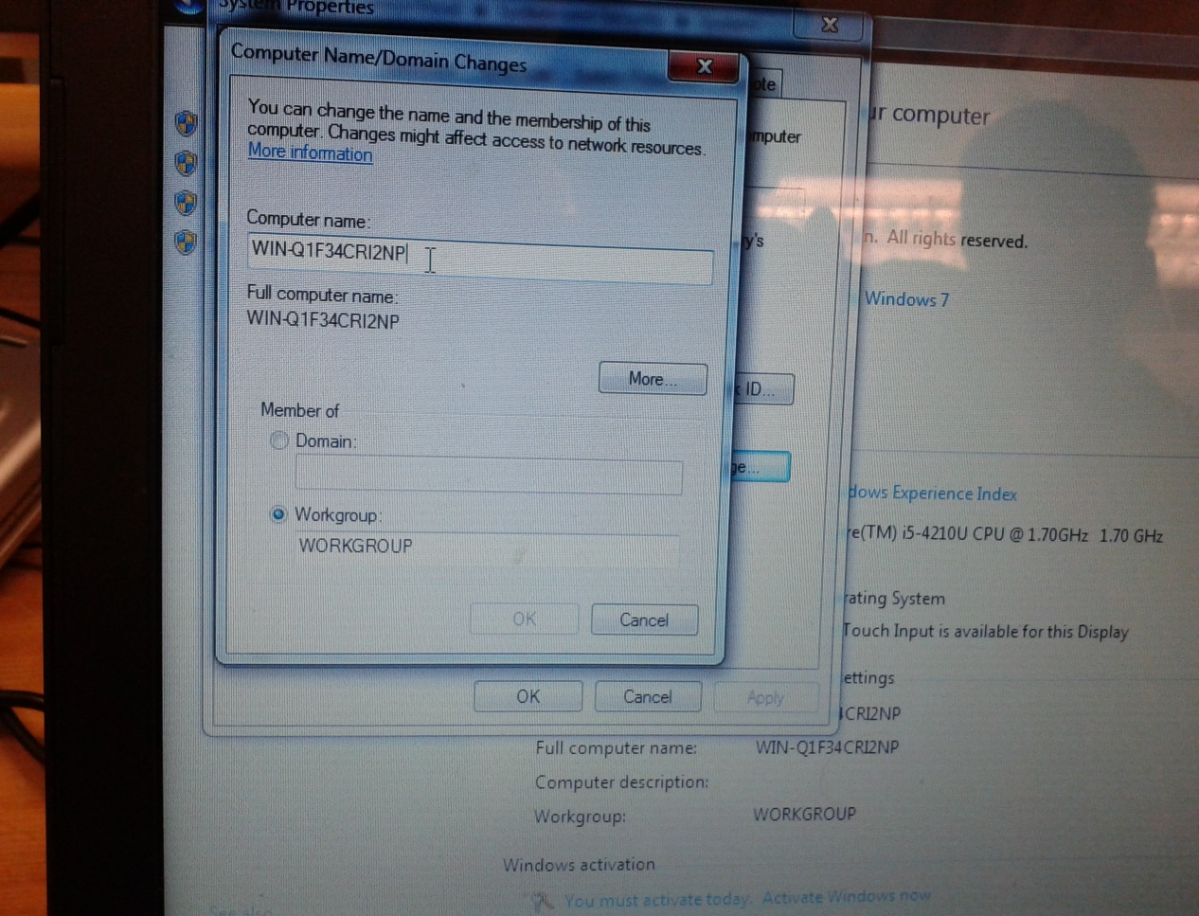
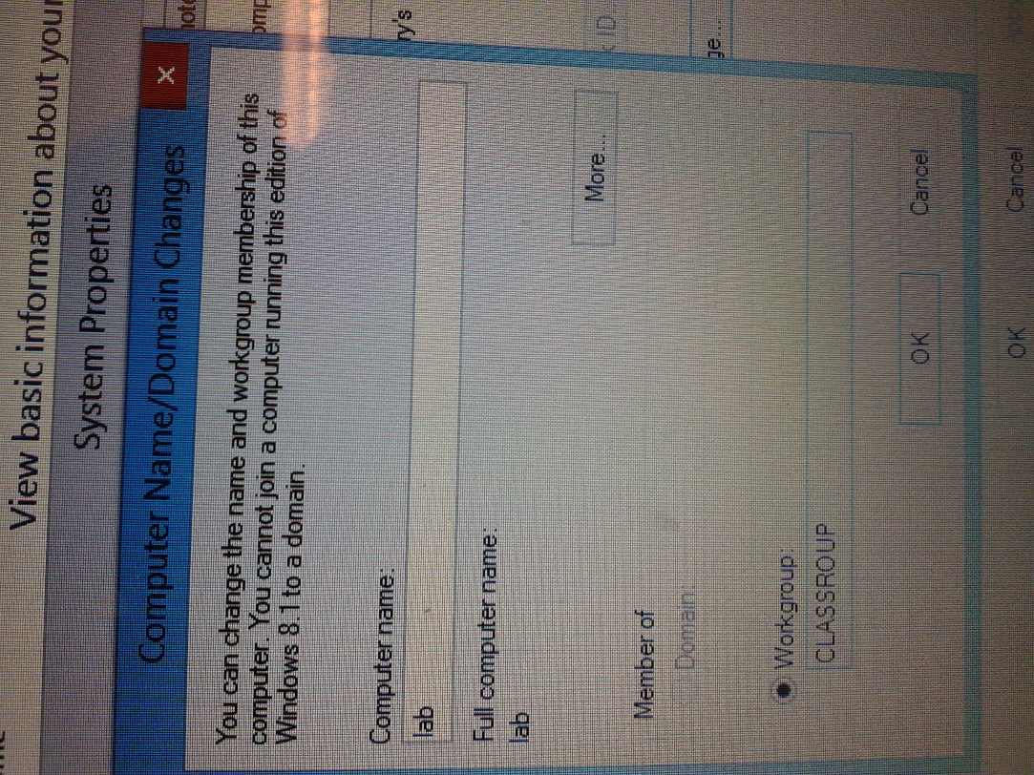
Change the name of computer and workgroup membership

Slide 12
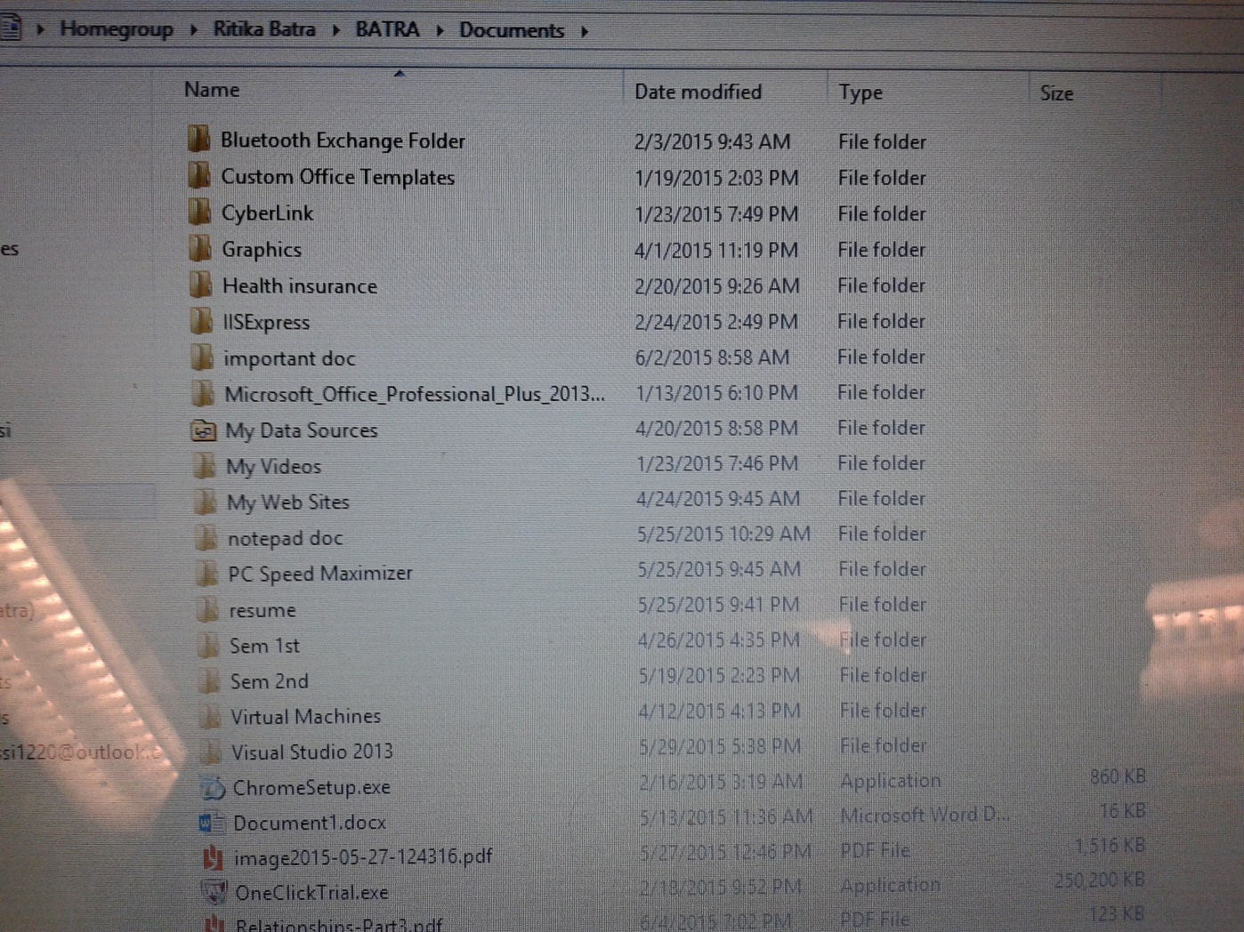
One PC see the documents of another PC

Slide 13
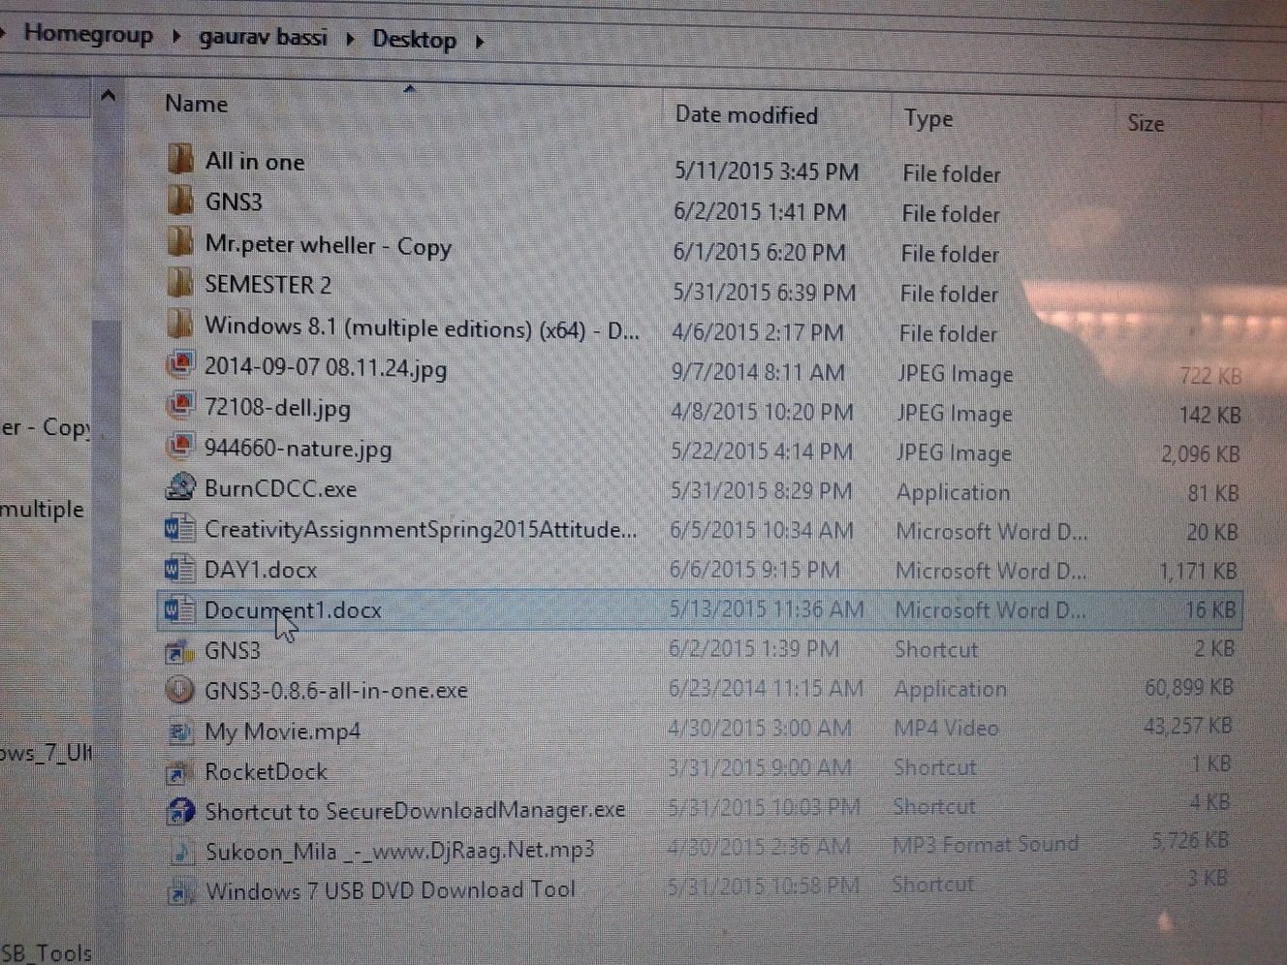
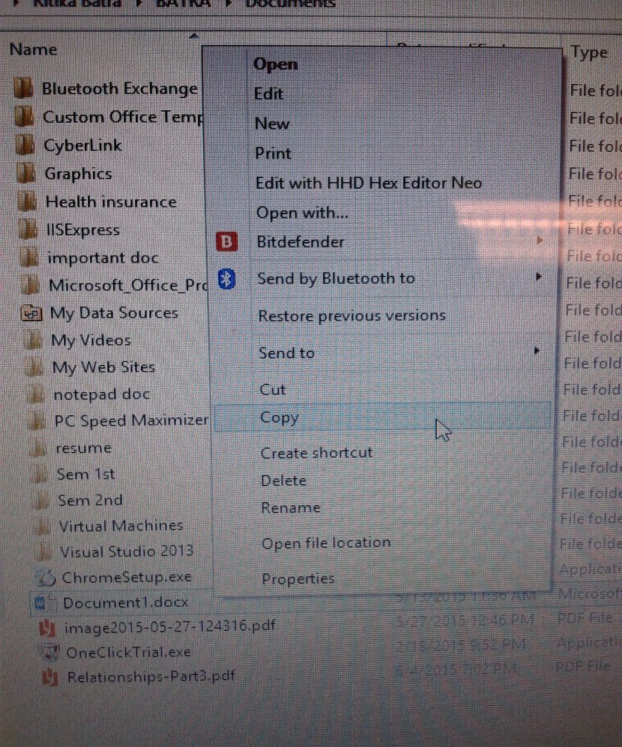
Copy file from one PC and Paste it to another File is shared

